Slide 1
Final Software Project
Benjamin Amrine
The University of Arizona Global Campus
CST 499: Capstone for Computer Software Technology
Dr. Amr Elchouemi
October 31, 2022

Slide 2

CST 499 FINAL PROJECT
ACADEMIC ENROLMENT WEBSITE

Slide 3
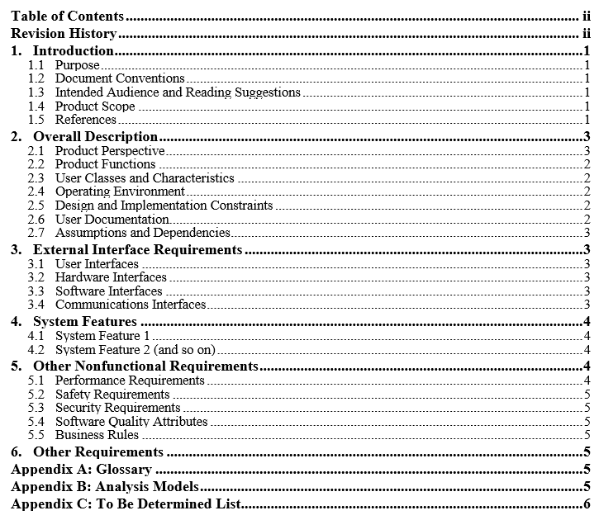
SRS REQUIREMENTS SPECIFICATION

Slide 4

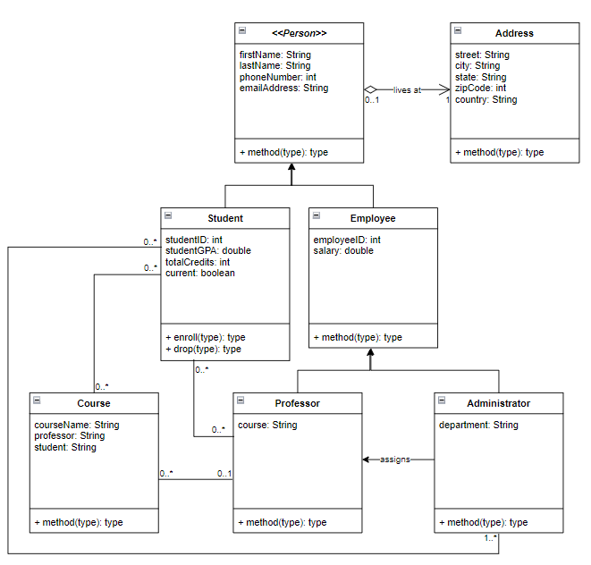
UML DESIGN MODELS

Slide 5

WEBSITE DESIGN
Landing
Login
Enrollment

Slide 6
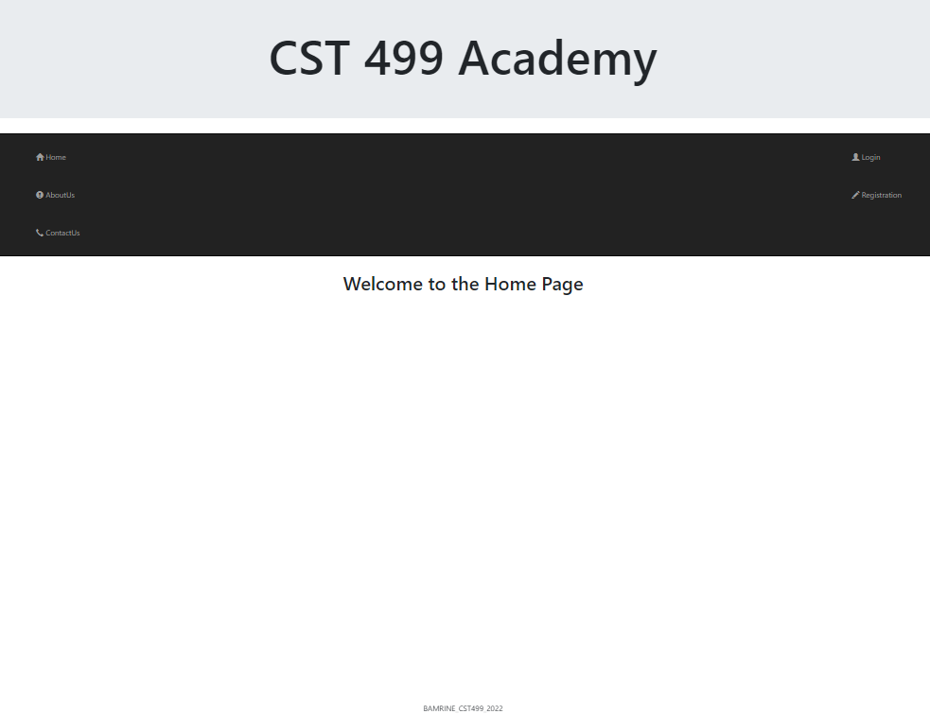
Landing Page
Home
About Us
Contact Us
Login
Registration

Slide 7
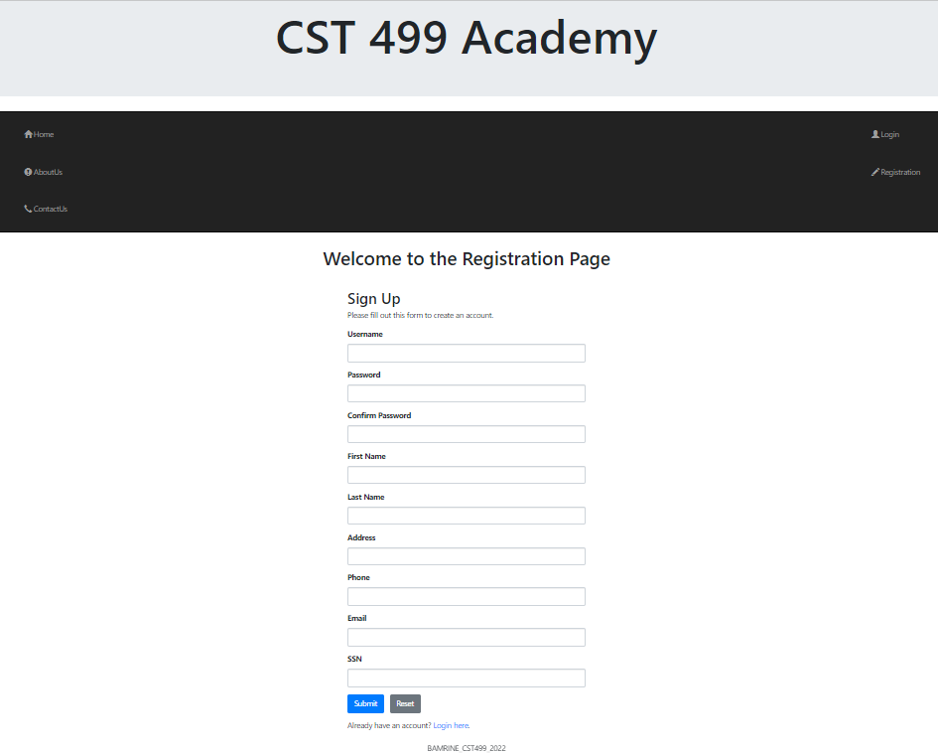
Registration Page
Home
About Us
Contact Us
Login
Registration

Slide 8
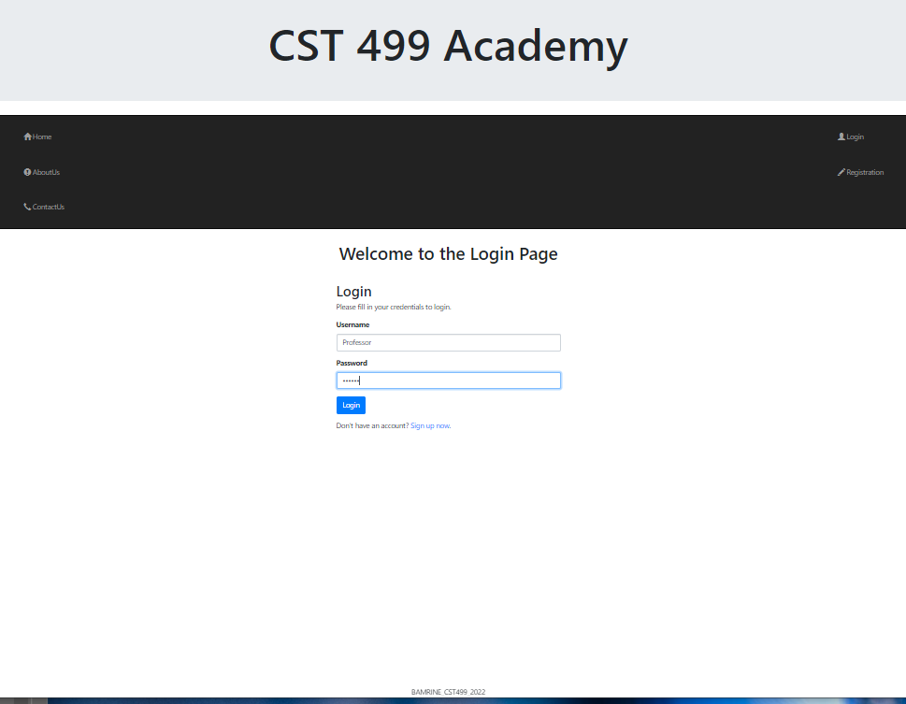
Login Page
Home
About Us
Contact Us
Login
Registration

Slide 9
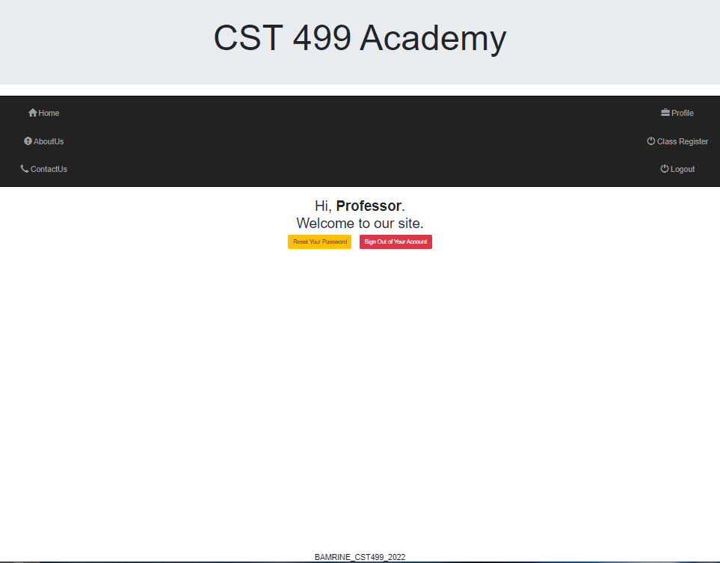
Welcome Page
Home
About Us
Contact Us
Profile
Class Registration
Logout

Slide 10
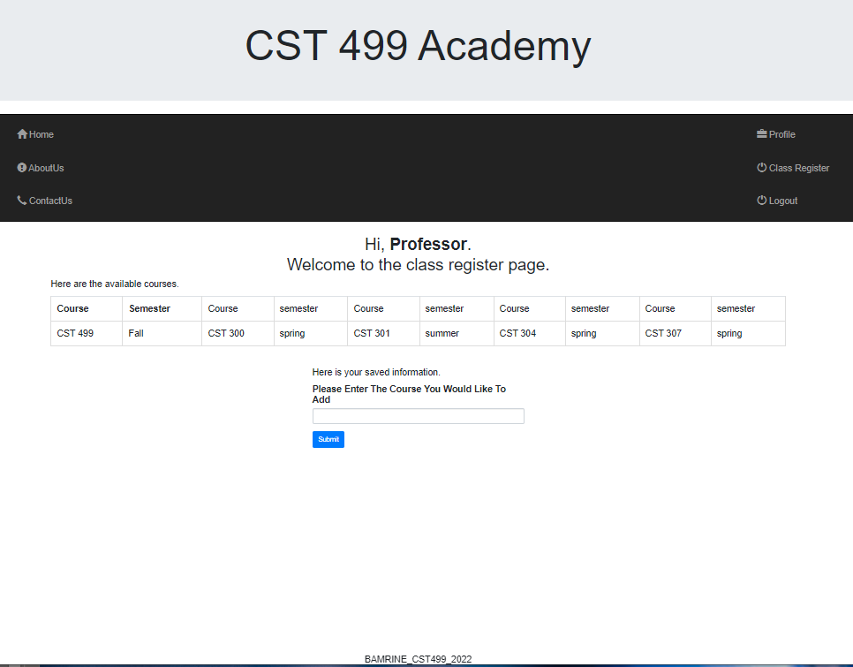
Class Registraion Page
Home
About Us
Contact Us
Profile
Class Registration
Logout

Slide 11
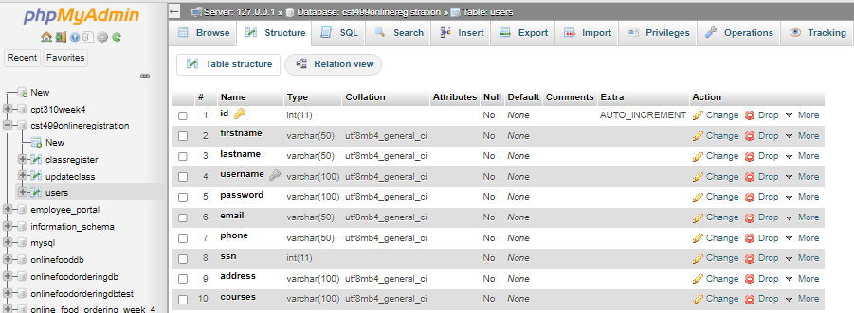
DATABASE - USERS TABLE

Slide 12
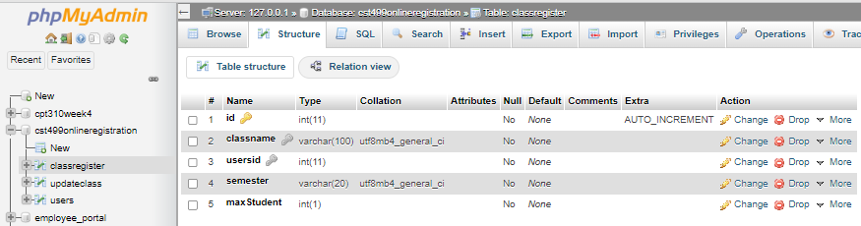
DATABASE - CLASSREGISTRATION TABLE

Slide 13
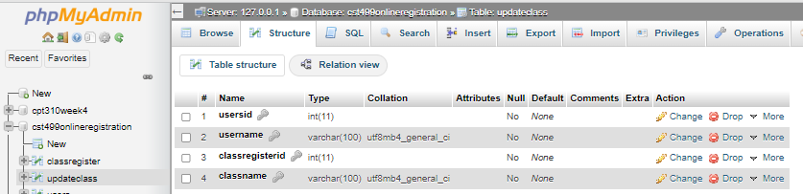
DATABASE – UPDATECLASS TABLE

Slide 14
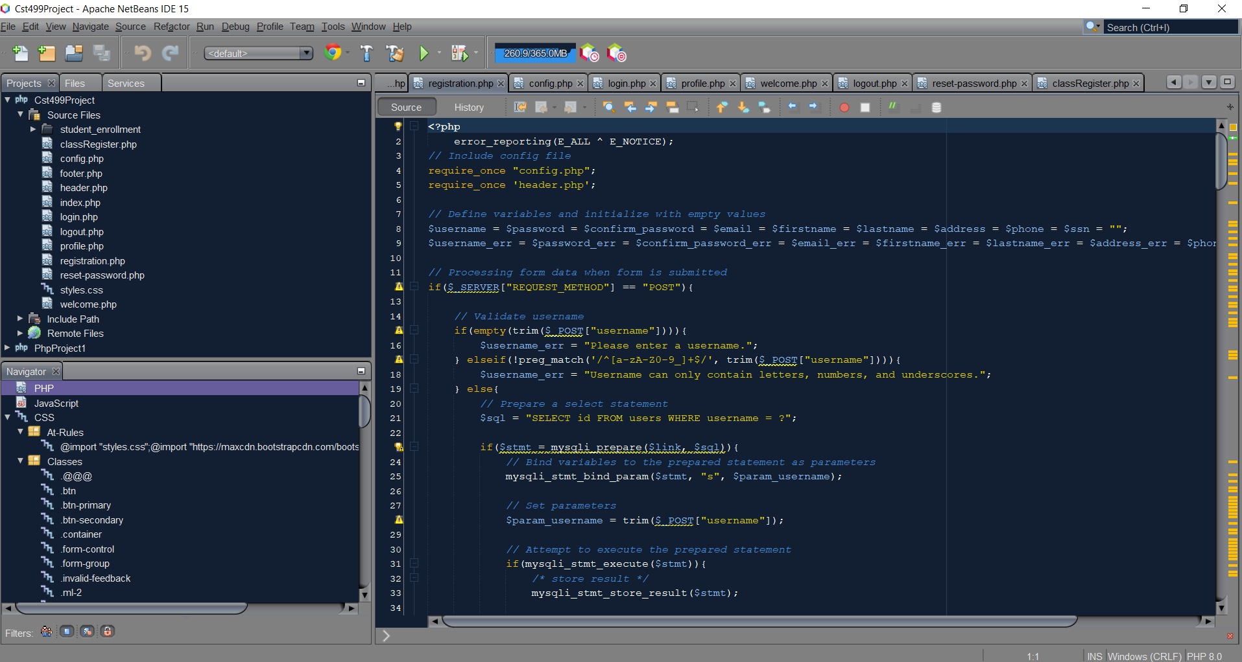
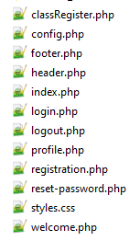
SOURCE CODE

Slide 15

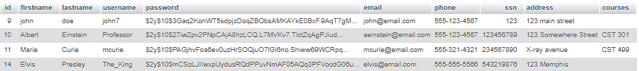
Thank You
Benjamin.amrine@student.uagc.student.edu

